Slide 1
Healthcare and Pharma overview
Our Expertise and Case Studies

Slide 2


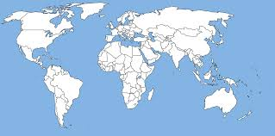


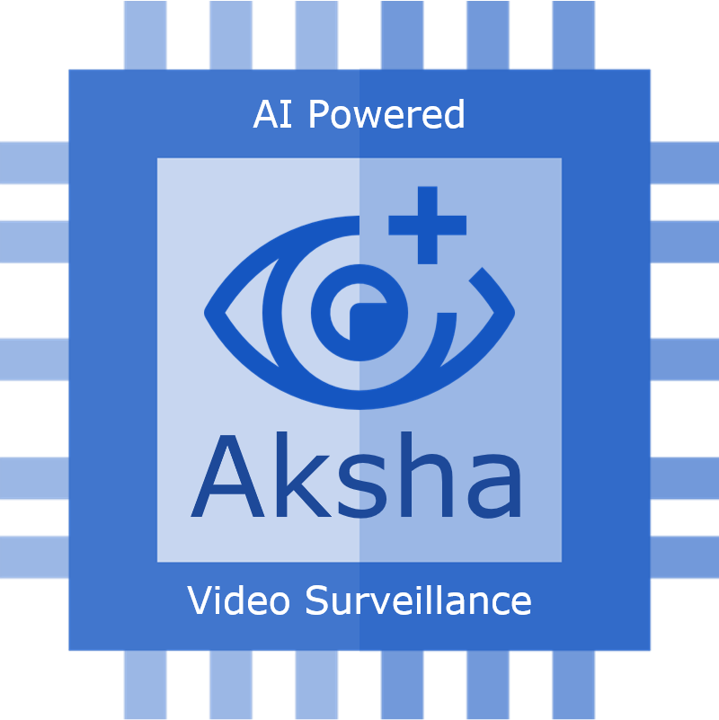




AlgoAnalytics – An Overview
Our Offerings
Who we are
Custom AI Solution Development
AI R&D and Consulting
We are a specialist Data Analytics company focused on building AI/ML powered solutions to solve business problems
* We are an NTT Data invested company *
Services
What makes us Special
Cloud Data Engineering
Large Language/ Foundational Models
100+ AI solution implementation experience
Work across domains, business problems and multi-model data
Strong capabilities in Classical ML, Deep learning as well as emerging tech like Quantum Computing and Digital Twin
Emerging Technologies
Quantum Computing
Digital Twin
Client locations
Our Partners
Products
AI-powered video surveillance
AI-powered parts inspection
NLP based analytics platform
AlgoAnalytics Pvt. Ltd
Notes:
We have technical expertise across multiple spheres of AI/ML and Cloud.
Our expertise with Deep Learning algorithms can efficiently deploy the high level statistical and AI models on the various Cloud Platforms.
Since our inception, our hands-on approach and in-depth knowledge of multiple input data types has been successfully implemented for our global clients.

Slide 3
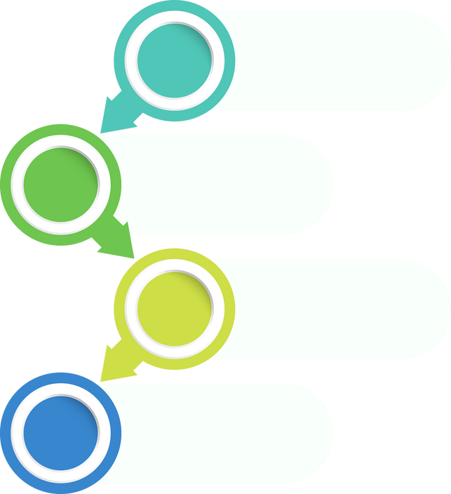



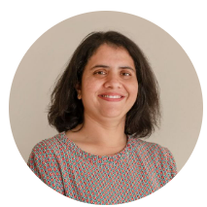

Strong Foundations backed by Industry Leaders
The Management Team
Founded in 2016 as a niche Data Analytics company
Aniruddha Pant, Founder & CEO
PhD, Control Systems, University of California at Berkeley, USA 2001, 20+ years of experience in Machine learning. Expertise across financial engineering, quant trading and deep learning
NTT Data engagement started in 2017
Girish Patil, Co-founder & CFO
BE/PGDBA, Director and CFO at AlgoAnalytics, cross functional including Quantitative trading, Finance, Operations, Legal, HR.
Built expertise in Deep Learning and AI solutions on Cloud
Anand Deshpande, Co-founder & CSO
PhD, Mechanical Engineering, University of Colorado at Boulder, USA 2001, 20+ years of experience in world-class research labs. Expert in mathematical modelling
Advisors
NTT Data Intellilink (NDIL) investment in 2023
Kanchan Pant, Advisor Manufacturing
MS, Marketing, USA, 15+ years of experience in running a manufacturing company.
Sayali Mahashur, Advisor Capital Markets
CFA (ICFAI), 12+ years of core finance experience.

Slide 4
AI in Healthcare
Our work and Offerings

Slide 5

Evolution of AI in Healthcare
Factors contributing to the growth in Healthcare AI
1970
1980s -1990s
2010-20
2020-2023
Exponential increase in computing power
Growth of genomic sequencing database
Widespread implementation of Electronic Medical Record (EMR) Systems
Enhancements in Natural Language Processing (NLP) and computer vision
Enhanced precision in micro-mechanics required for Robotic surgeries
Rise of Generative AI
Medical imaging & diagnostics
Virtual Assistants (Chatbots)
Medical AI
Faster data collection & processing
Assisting in precise surgical procedures
MYCIN
An AI program that identifies blood infection treatments
2010: CAD applied to Endoscopy
2017: First FDA approved Deep Learning application to detect heart problems

Slide 6

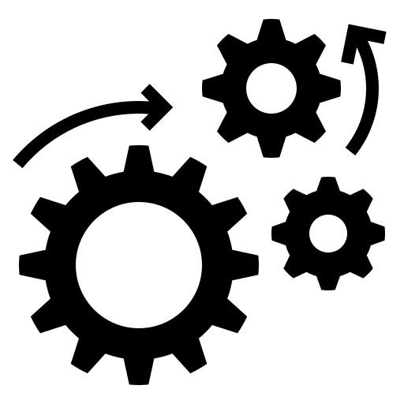


Offerings for Healthcare and Pharma
Natural Language Processing (NLP) applications
Foundational/ Large Language Models (LLM) applications
Computer Vision based Medical/ pharma applications
Text and Image Analytics
Medical terms extraction from clinical notes
Automation of Discharge summary creation
Patient Condition Prediction using physiological measurments
Entity and intent detection from nursing notes
Pathology report parsing, Patient knowledge graph
AI-based Process Automation
AI application development for Cloud
ML Ops and Data Ops
ML services in Cloud
AI for Cloud
Next-Gen Technologies
Generative AI based applications
Federated Learning
Digital Twin
Quantum Computing

Slide 7
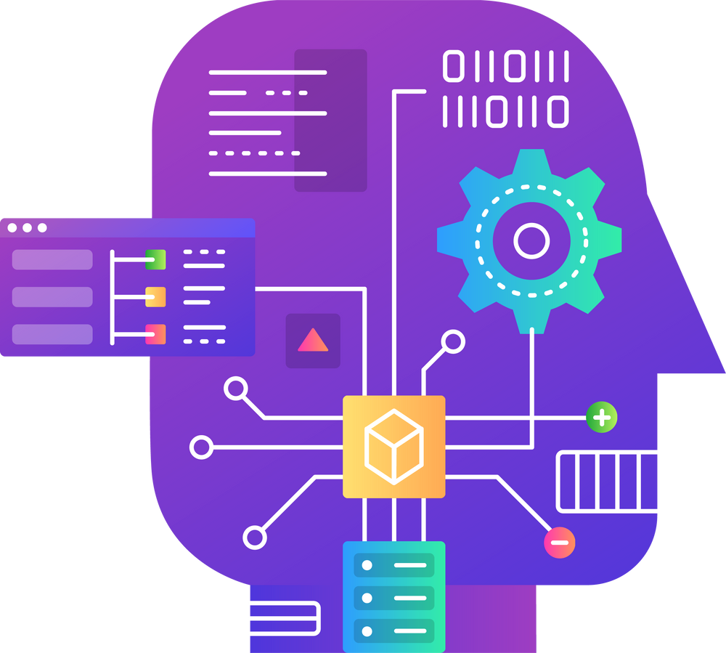
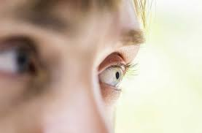
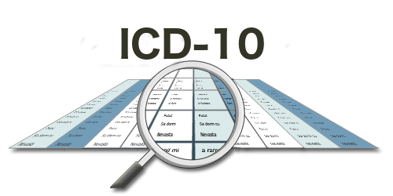



Few Healthcare AI Project Summaries
AI Mirror using LLM
Diabetic Retinopathy Detection using Computer Vision
ICD Coding Assistant using NLP
Developed a Gen AI application to create a mirror of senior citizens
Levraging image processing techniques to successfully predict Retinopathy of severity Grade 2 and 3
Automatically suggest appropriate ICD codes based on medical records of the patient
AI Features for Pharma Consulting Platform using NLP
Medical Term Extraction from Clinical letters using NLP
Pathology Lab Report Parsing using NLP
Build foundational functions/modules to provide trend and temporal analysis based on news and social media text data
Extract key medical term from the clinical letters shared across medical practitioner
Extracts the unstructured data from pathology lab reports and translate to structured data which is useful for downstream applications

Slide 8
Generative AI
Our work in Foundational/ Large Language Models (LLM)

Slide 9
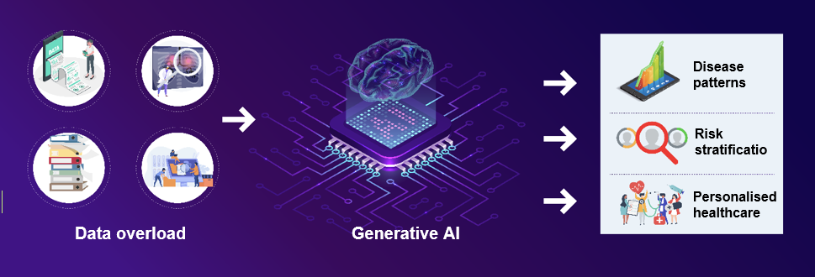
Large Language Models (LLM)
Generative AI is a type of AI that creates new content or synthetic data based on what it has learned from a given dataset.
Generative AI
Large Language Models (LLM) are a type of Deep Learning AI model notable for its ability to achieve general-purpose Language understanding and generation
LLM
Medical or Healthcare large language models (LLMs) are advanced AI-powered systems designed to understand & process vast amount of medical text
They possess the ability to
Comprehend complex medical texts
Extract meaningful information
Generate valuable insights for healthcare professionals

Slide 10
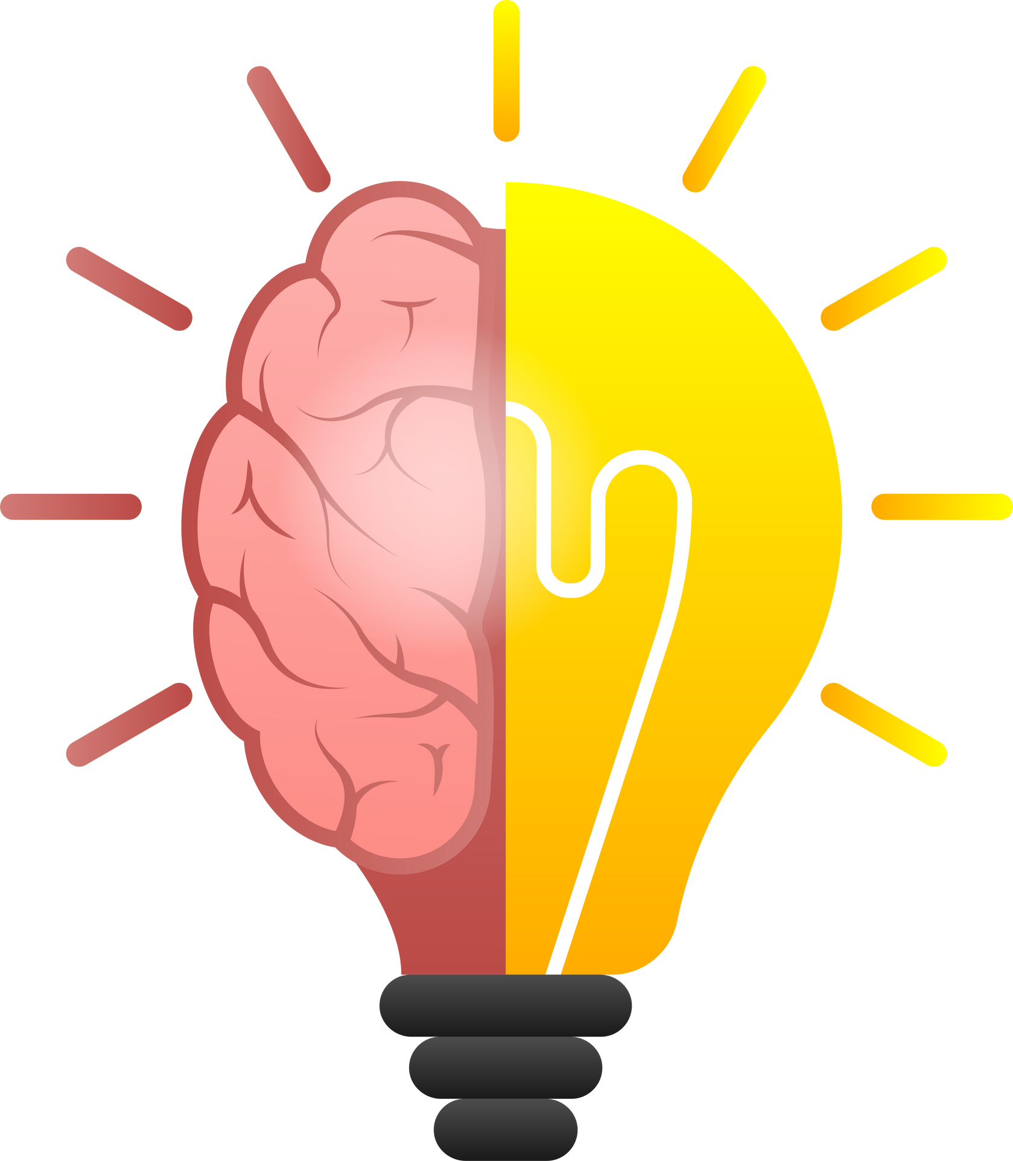
LLMs are finding Applications in every Healthcare Segment
Healthcare chatbots
Predictive Health outcomes
Drug Discovery & Development
Clinical Decision Support
Personalized Treatment Plans
Subject to risks such as..
Data privacy concerns
Embedded bias
Robustness
Synthetic data
Explainability
Electronic Health Record (EHR) enhancement
Medical Imaging Analysis
Medical Transcription
Ethics & Compliance monitoring
Notes:
Sources:
https://research.aimultiple.com/large-language-models-in-healthcare/#:~:text=While%20primarily%20text%2Doriented%2C%20LLMs,potential%20health%20risks%20or%20patterns.
https://www.johnsnowlabs.com/the-power-of-medical-large-language-models-llms-in-healthcare/

Slide 11
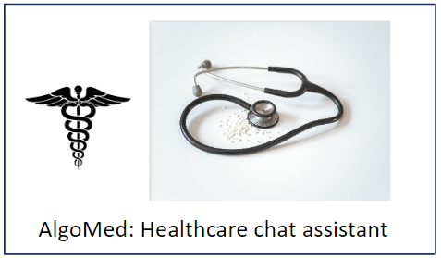
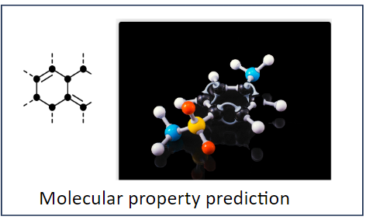
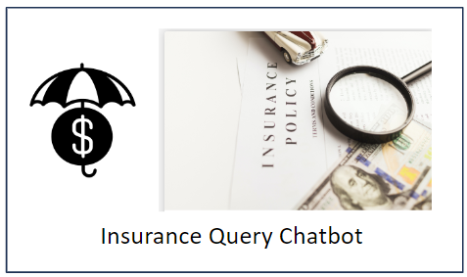
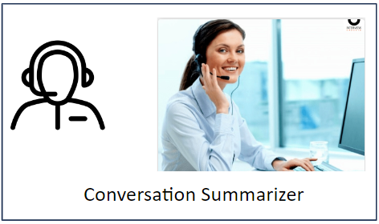
Our LLM Center of Excellence (CoE)
https://apps.onestop.ai/llm-dashboard/
We use a combination of Open-source and Closed-source frameworks to build these applications
Our current LLM powered accelerators that can leveraged in Healthcare and Pharma domain
Medical AI chatbot to answer from medical documents and summarize information
Predict molecular properties for enhanced drug discovery using AI
Effortlessly query insurance/ contract documents to know specific information just by uploading your documents.
Efficiently distill customer-service agent interactions into concise, easy-to-read summaries,
AlgoAnalytics Pvt. Ltd
Strictly Confidential
‹#›

Slide 12
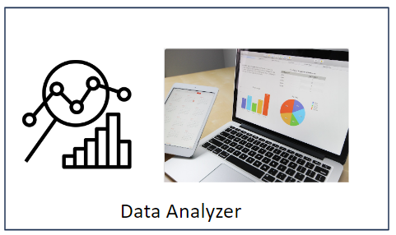
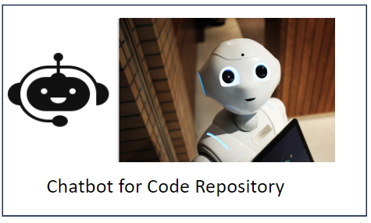

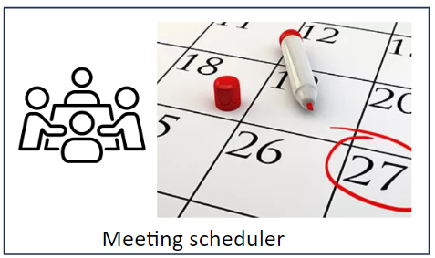
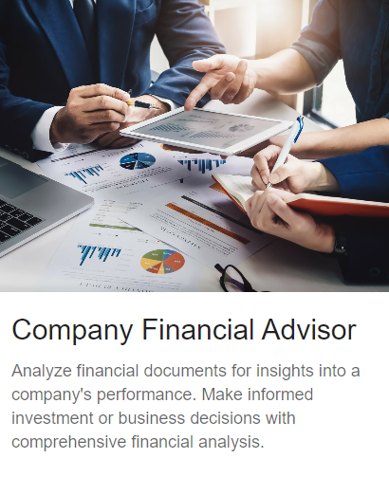

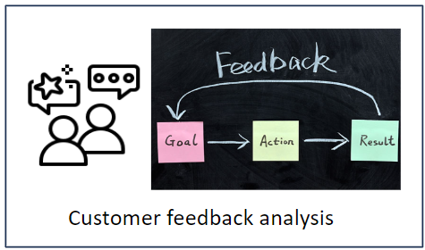
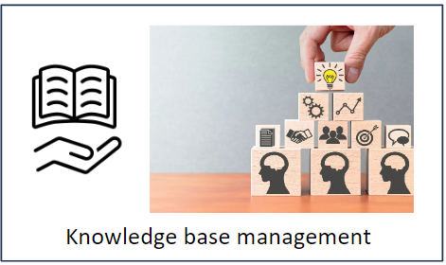
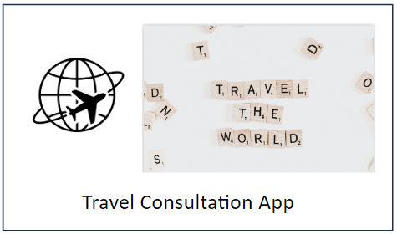
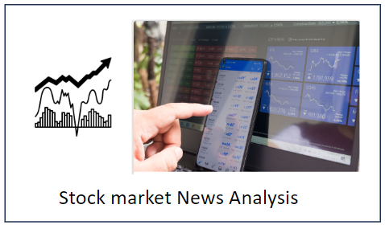
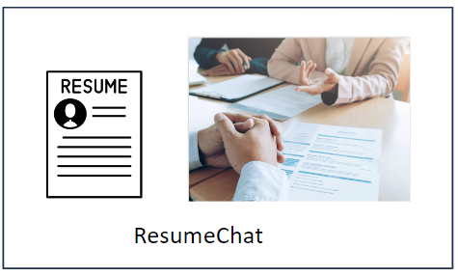
Our LLM Center of Excellence (CoE)
https://apps.onestop.ai/llm-dashboard/
Range of other LLM applications available on our demo portal
Company Financial Advisor
Analyze financial documents for insights into a company's performance. with comprehensive financial analysis.
Effortlessly manage diverse data formats; upload, interpret, and gain valuable insights
Chatbot to schedule meetings with date & time suggestions
Query your code repository to get the latest status of the code
Chatbot to assist in onboarding a new employee for a smooth transition
Analyzes feedback through sentiment analysis to aid corporate clients in enhancing customer satisfaction and loyalty
Establish and manage a quick-access knowledge base for employees by organizing unstructured data (documents, procedures, FAQ)
Chatbot for planning your travel to a particular destination
Chatbot to get curated financial information from stock market news
Chatbot to find the right candidates with relevant skills
Many other apps are under development..
AlgoAnalytics Pvt. Ltd
Strictly Confidential
‹#›

Slide 13
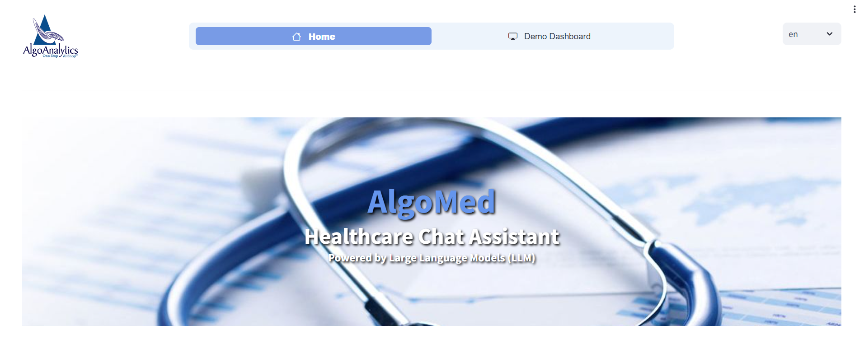
AlgoMed : Healthcare Chat Assistant
Objective
Help patients grasp complex medical jargon by providing easy-to-understand explanations and offer valuable medical insights on various illnesses.
Data : BioASQ data consists of PubMed Articles and extracts over many medical topics.
Framework : LangChain
Index : Character Text Splitter, Hugging Face Embeddings, OpenAI Embeddings, FAISS
Prompt : Custom Prompt designed to confine the use of its own knowledge and is engineered to respond in simple, everyday language to enhance user comprehension.
LLM : GPT-3.5 turbo
RetrievalQA based model uses similarity search.
Demo : Healthcare Chat Assistant

Slide 14
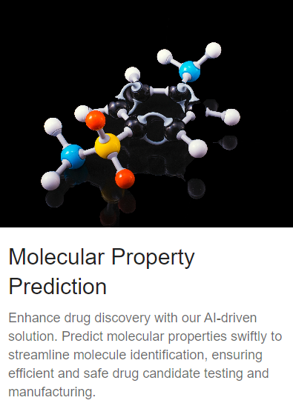
Molecular Property Prediction
Objective
Predict molecular properties swiftly to streamline molecule identification
Data :
List of SMILES notation and associated molecular properties (csv format)
Framework : HuggingFace Transformers
Index : Not used
Prompt : Custom prompt template to enable LLM to generate answers based on user input
LLM : ChemBERTa-77M-MTR
Demo : Molecular Propoerty Prediction

Slide 15
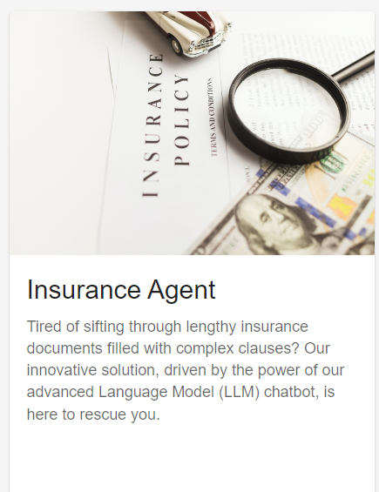
Insurance Query Chatbot
Objective
Interpret prompts with respect to insurance policy along with terms and conditions
Data : (combined)
2 wheeler Insurance policy (pdf)
Policy general FAQ (pdf)
2 wheeler policy terms & conditions (pdf)
Index : List Based (in-memory) and Pinecone (external)
Prompt : Custom prompt template to prevent the LLM to retrieve from its own knowledge base
LLM : GPT-3.5 turbo
Retrieval mode : Compact
Demo : Insurance Agent Service

Slide 16
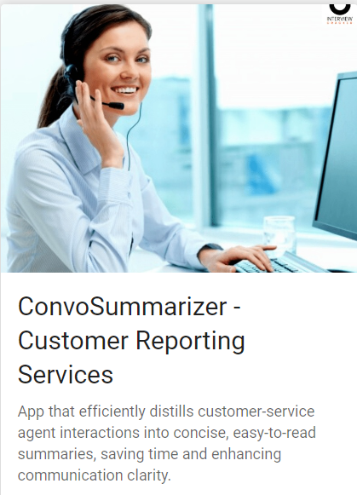
Conversation Summarizing Agent
Objective
Summarize and interact with customer-service agent interactions with concise, easy-to-read summaries, saving time and enhancing communication clarity.
Data :
Different types of conversation documents (txt format) between customer and customer representative.
Framework : LangChain
Index : DocArray InMemorySearch
Prompt : Custom prompt template to enable LLM chains based on user input and model recommendations.
LLM : GPT-3.5 turbo
Chain : Conversational Retrieval Chain and load summarize chain
Demo : ConvoSummarizer

Slide 17
Case Studies
Our past work with Healthcare and Pharma organizations

Slide 18
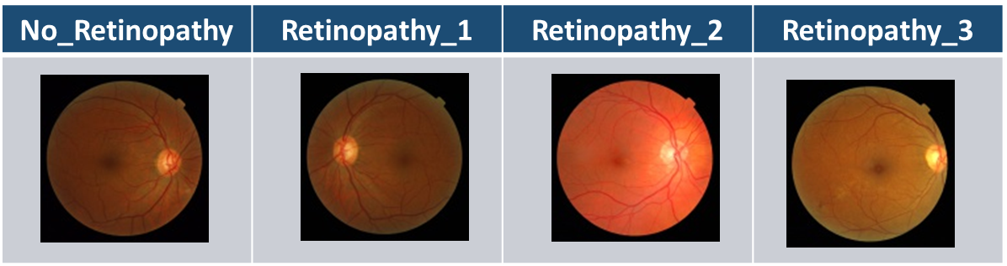
Diabetic Retinopathy Detection using Computer Vision
Diabetic Retinopathy is the leading cause of blindness in the working-age population of the developed world. It is estimated to affect over 93 million people
Need of expertise and equipment required to detect DR is very high and is often unavailable in areas where requirement is high.
Images are classified into four classes according to their retinopathy grades:
Input Images are processed using Image Processing techniques
ML techniques such as neural networks and classifiers are used
Successful classification into one of the four class
Results
Successful in predicting Retinopathy of severity grade 2 and 3 with more than 90% accuracy
If fundus images for both the eyes of the patient are available, the model will predict Retinopathy 2/3 with 99+ percent accuracy!

Slide 19





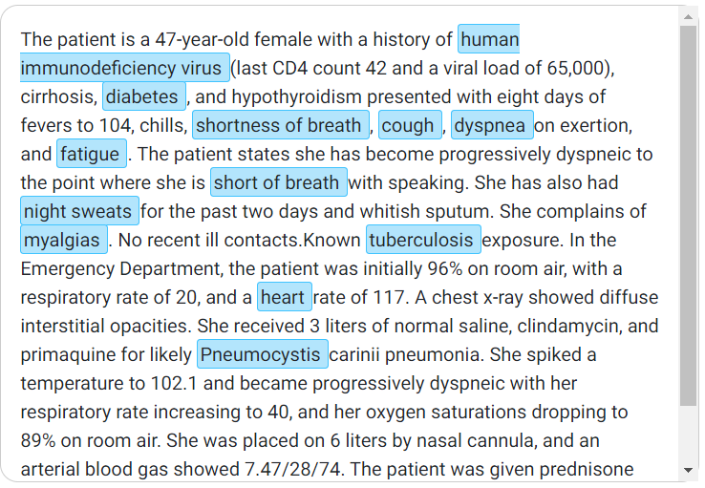
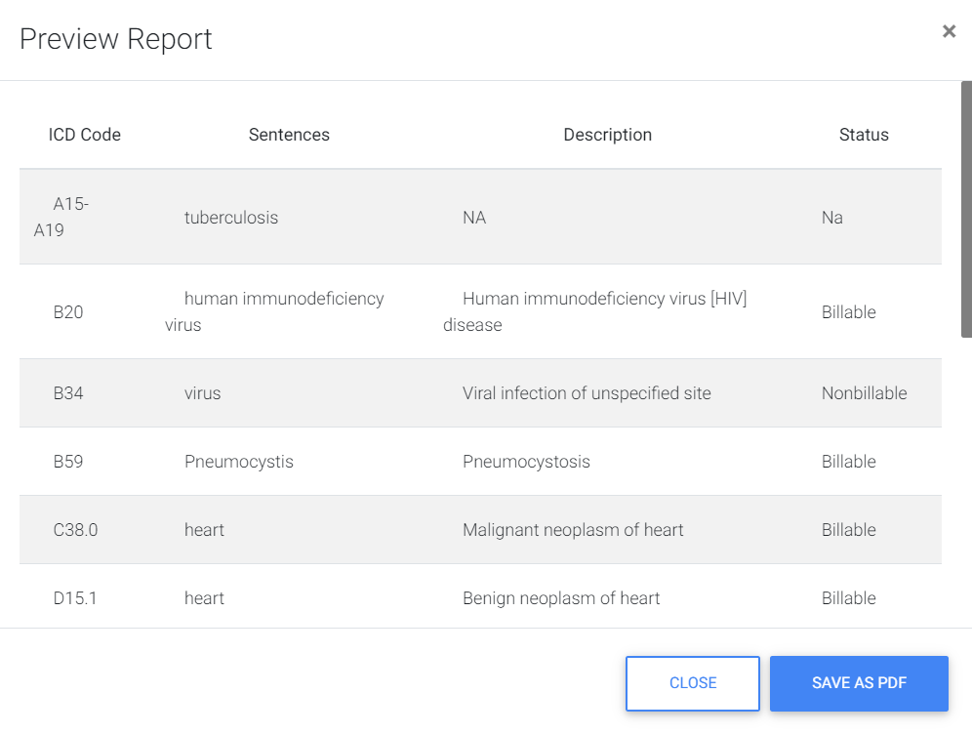
ICD Coding Assistant using NLP
Automatically suggest appropriate ICD codes based on medical records of the patient
Medical Text Sentences
Human Coder
ICD Codes
NLP Methodologies (Classification & Extraction)
ICD-10 Coding Book
Benefits
Empower human coder with NLP solution to maximize their productivity
Eliminate audit and investigation of health care provider due to over-coding
Increases customer satisfaction by eliminating under-coding
Results
Demo : ICD Coding

Slide 20
AI Features for Pharma Consulting Platform using NLP
For a UK based pharma consultancy organization specializing in dynamic decision support and product/portfolio strategy.
Build foundational functions/modules to provide trend and temporal analysis based on news and social media text data
Data Acquisition from News Media and Social Media
Pharma Consulting Platform :
Projects Executed
Named Entity Recognition (NER) on news data and tweets data
Sentiment Analysis for news and tweets data
Confidence Detection on news data and tweets data
Notes:
Client: Prescient Healthcare Group - London, UK

Slide 21
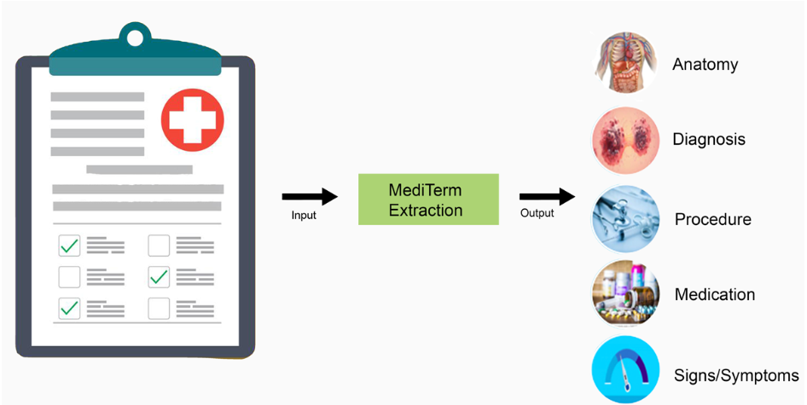
Medical Term Extraction from Clinical letters using NLP
Key Objectives
Results
Extract key medical term from the clinical letters shared across medical practitioner
Dear Dr
Clinic notes
Many thanks for referring this lady who last year was awoken at night by moderately fast regular palpitations which had a gradual offset. These symptoms have not recurred. She is otherwise well although is on treatment for hypertension. She stopped smoking 60 years ago and drinks rarely. Recent thyroid function tests have shown a slightly elevated TSH but a normal free thyroxine. Apart from amlodipine 5 mg daily, she takes simvastatin and calcium supplements. Her ECG showed sinus rhythm with a leftward axis. Ambulatory monitoring has shown sinus rhythm with first degree heart block at lower rates and two short salvos of atrial tachycardia of no more than 2 seconds. She was asymptomatic to these. I would pass her tape as within normal limits for the patient, and in the absence of ongoing symptoms would not suggest any specific treatment. I will arrange for an echocardiogram, however, and will write back further with the results. If she does suffer further palpitations, a small dose of bisoprolol such as 1.25 mg daily would be reasonable. With many thanks for your referral.
Yours sincerely
cc list Consultant
Sign and Symptoms : Moderately fast regular palpitations | Diagnosis : elevated TSH , normal free thyroxine , first degree heart block atrial tachycardia
Medication Ongoing : amlodipine 5mg daily, simvastatin and calcium supplements | Procedure Suggested : echocardiogram
Procedure : thyroid function tests, ECG | Medication Suggested : bisoprolol 1.25 mg daily
Demo : Mediterm Extraction Solution
Notes:
Client: NHS, UK

Slide 22
Entity and Intent Detection for Nursing Notes using NLP
Key Objective : Create a model than can generate entity and intent at par with human expert
Client: Research project with NTT Data Japan
Can’t raise left upper limb, but right upper limb is okey. Both lower limb don’t perform default action.
AI/ ML Driven
Leveraging multiple NLP frameworks for smart detection
Text Processing
can not raise left upper limb.
right upper limb is okey.
both lower limb do not perform default action.
Key
Features
Entity Recognition
Intent Detection
can not raise left upper limb : Intent -> paralyzed
right upper limb is okey. : Intent -> not paralyzed
both lower limb do not perform default action. : Intent -> paralyzed
Multi-Lingual support
Two-level Approach
Easily scalable and can be modified to support multilingual input
Each Sentence is traverse through High level models followed by Sub-level models
Results and Outcomes
AlgoAnalytics model results are at par with IBM Watson results
The model was able to detect additional relevant entities, which were either not mentioned or missed in the list by human expert
Notes:
NTT Data R&D project

Slide 23
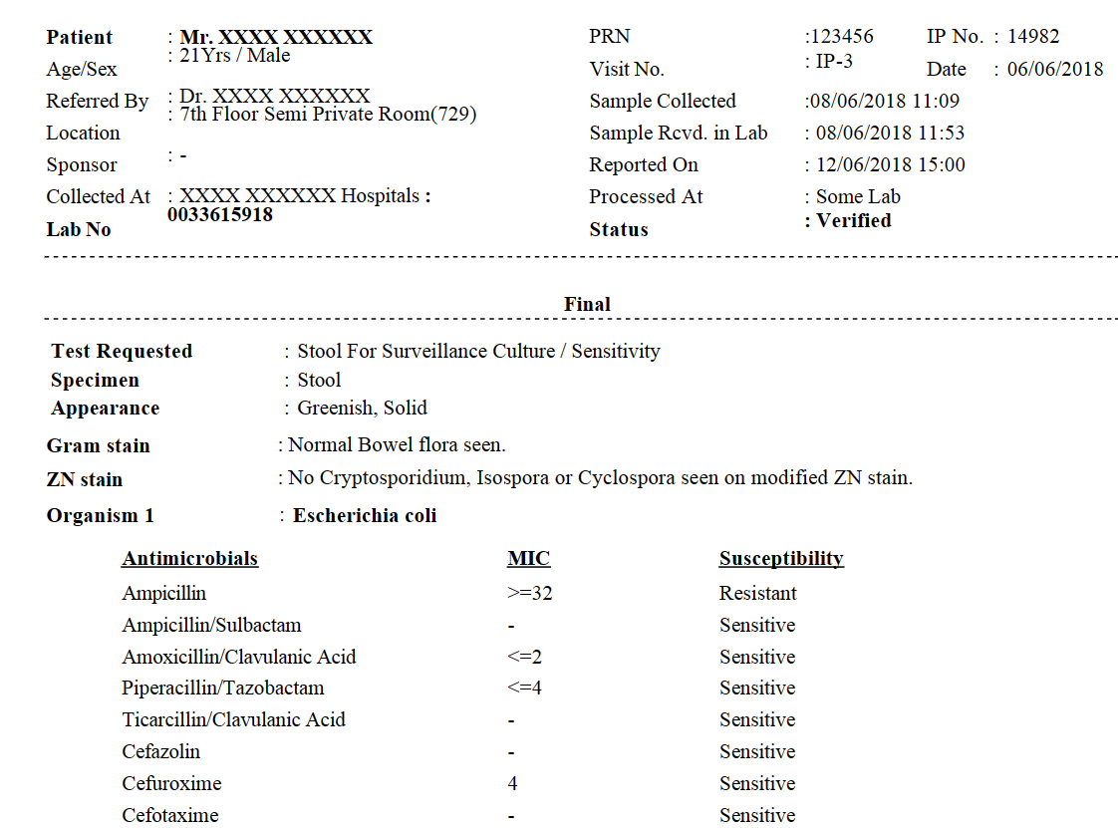
Pathology Lab Report Parsing using NLP
Key Objective : Extract relevant details from pathology lab reports
The lab report parsing extracts the unstructured data from pathology lab reports and translate to structured data which is useful for downstream applications
Pathology Lab Reports
Better Patient Management for hospitals and medical agencies
Effective Patient Care
Stage 1 : Identifying Terms and Patterns (Unsupervised Learning)
Creating and Compiling Patient Record
Stage 2 : Classification of Text into specific Categories
(Supervised Learning)
Demo : Pathology Lab Parsing
Notes:
Client: Indo Health Software Solutions Pvt. Ltd., India

Slide 24
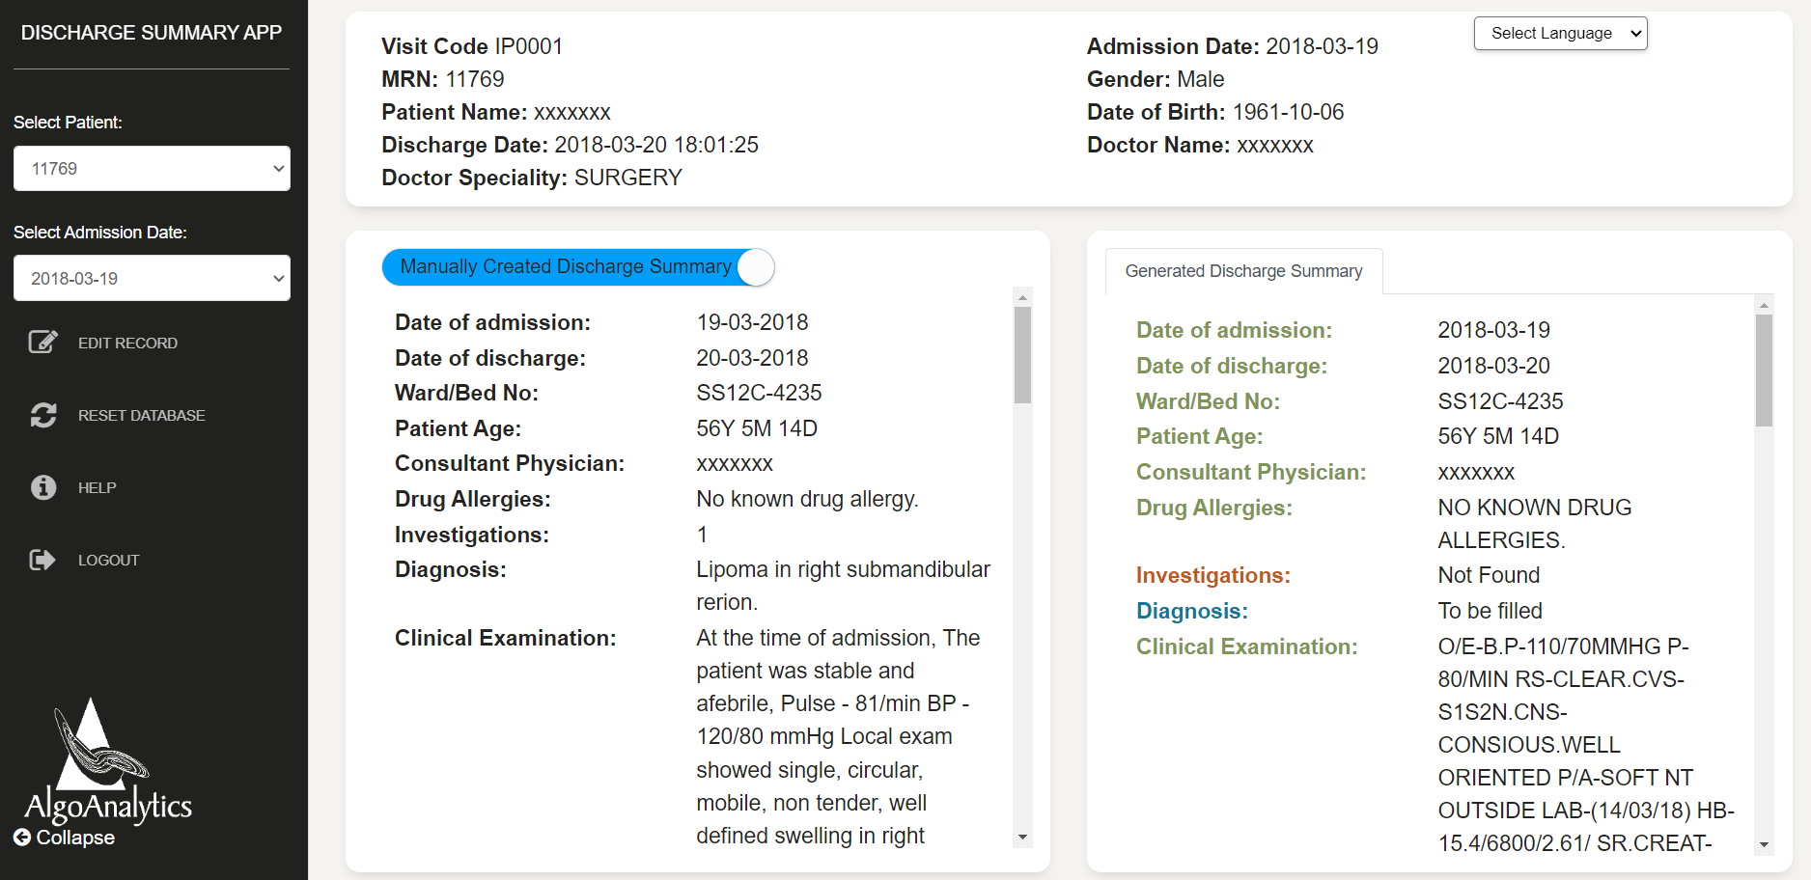
Discharge Summary using NLP
Key Objective : Automate Discharge summary using information extraction approach
Leveraging the power of AI to not only extract relevant information but also identify insights from the categorized text
Multiple reports are taken as input fields for generating discharge summary
CLINICAL_NOTE
OPERATIVE_REPORT
PATHOLOGY INVESTIGATION REPORT
RADIOLOGY INVESTIGATION REPORT
Color coding scheme for the Generated Discharge Summary:
Green Color : Able to find data from data source
Red Color : Not able to find data from data source
Blue Color : Need to be filled by doctor
Demo : Discharge Summary Application
Notes:
Deenanath Mangeshkar

Slide 25
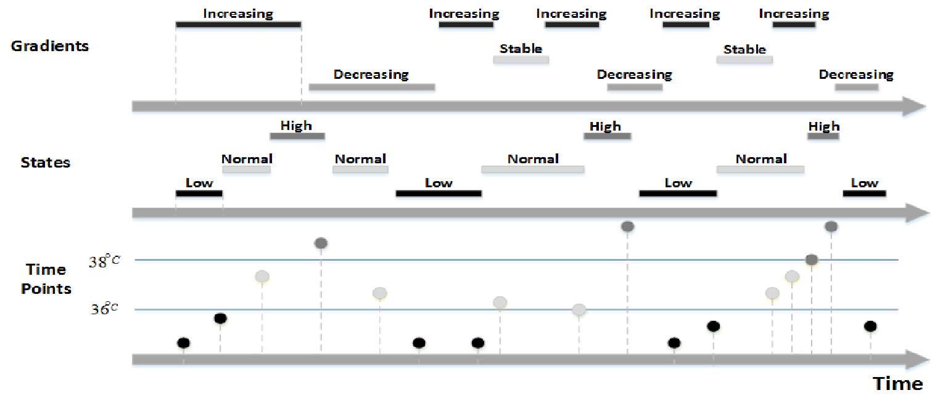
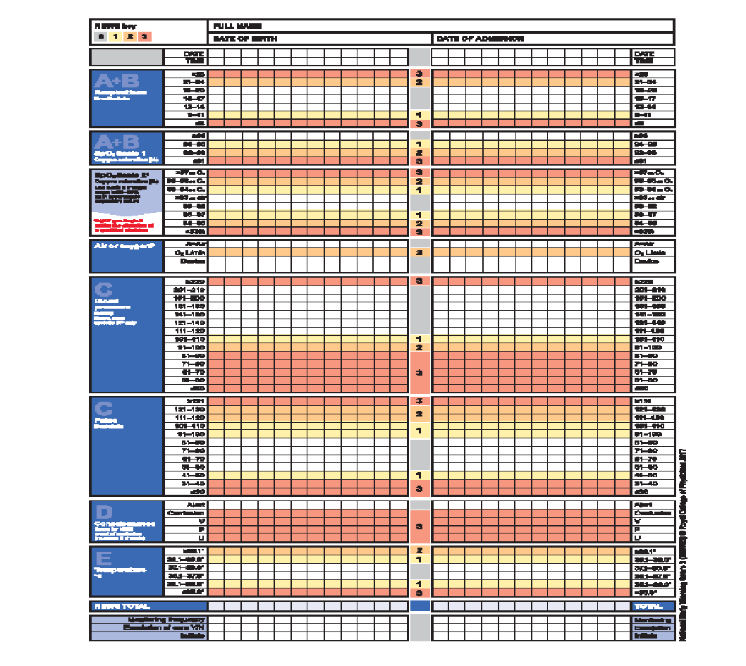
Patient Condition Prediction – Early Warning System
NEWS
National Early Warning System
AS-IS
Scoring system pertaining to patient medical condition
Based on the physiological parameters such as BP, RR, PR, O2S and TEMP
Magnitude of score depends on variation in parameter from the norm
Alert is generated based on the rules applied to aggregated score
TO-BE
NEWS tends to give many false alarms
NEWS may not generate alarm until rapid deterioration is observed
Build predictive system, than detective system, based on physiological measurements of hospital inpatients
Clinical: Prediction of medical condition
Operation: Generation of timely alerts
Research: Patient segmentation based on the patterns observed/emerged
AlgoAnalytics Pvt. Ltd.
Notes:
Project approach is “Temporal Data Mining 🡪 Temporal Abstraction 🡪 Temporal Relations 🡪 Time Interval Related Patterns”

Slide 26
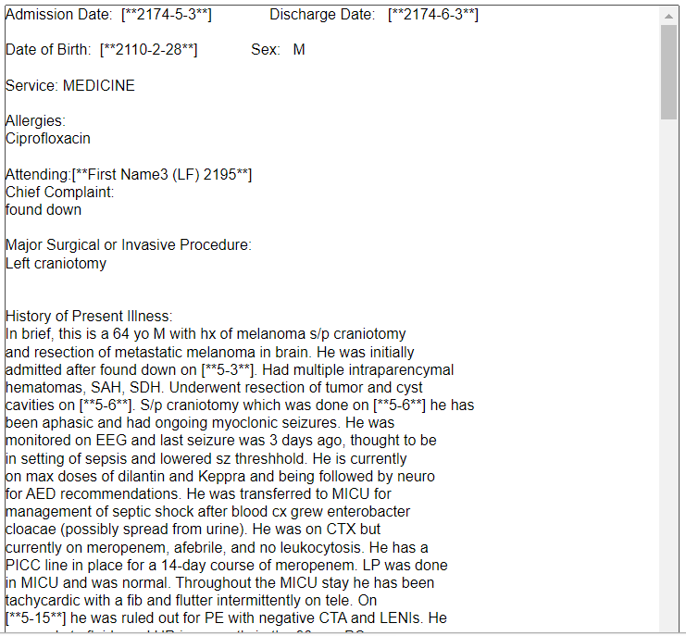
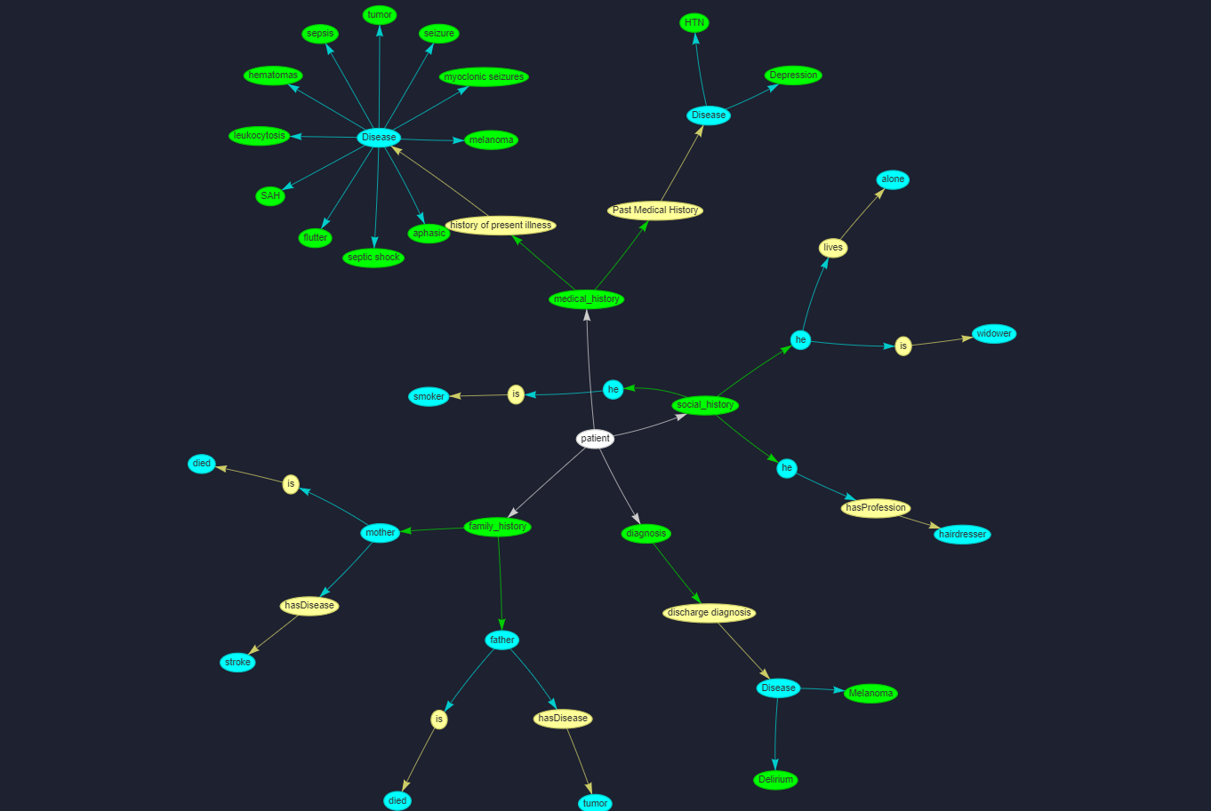
Patient Knowledge Graph
Extract patient history and diagnosis from unstructured text to structured data format viz. knowledge graph.
Enables to find the insights for individual patient as well as across patients through natural language queries.
Input : Multiple Medical documents
(Diagnosis Details, Social History, Family History etc.)
Knowledge Graph
Demo : Patient Knowledge Graph
Notes:
NTTD R&D project

Slide 27
Thank You
https://www.algoanalytics.com/
Onestop.ai

